Slide 1


Deep Learning for Natural Language Processing DLNLP 14: Encoder-decoder Methods
Mihai Surdeanu and Marco A. Valenzuela-Escárcega

Slide 2
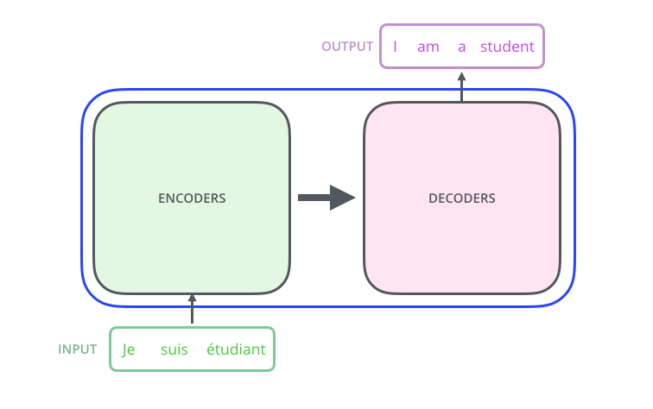
Overview
This lecture
Slide from http://jalammar.github.io/illustrated-transformer/

Slide 3
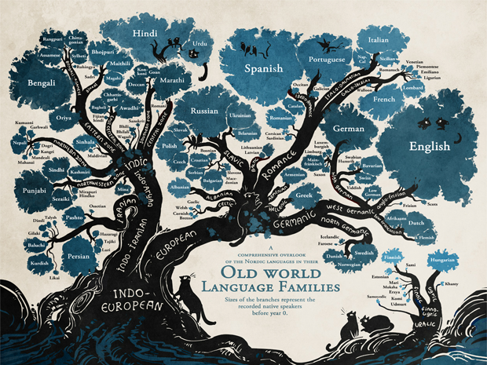
Motivation
Machine translation and chat bots!

Slide 4
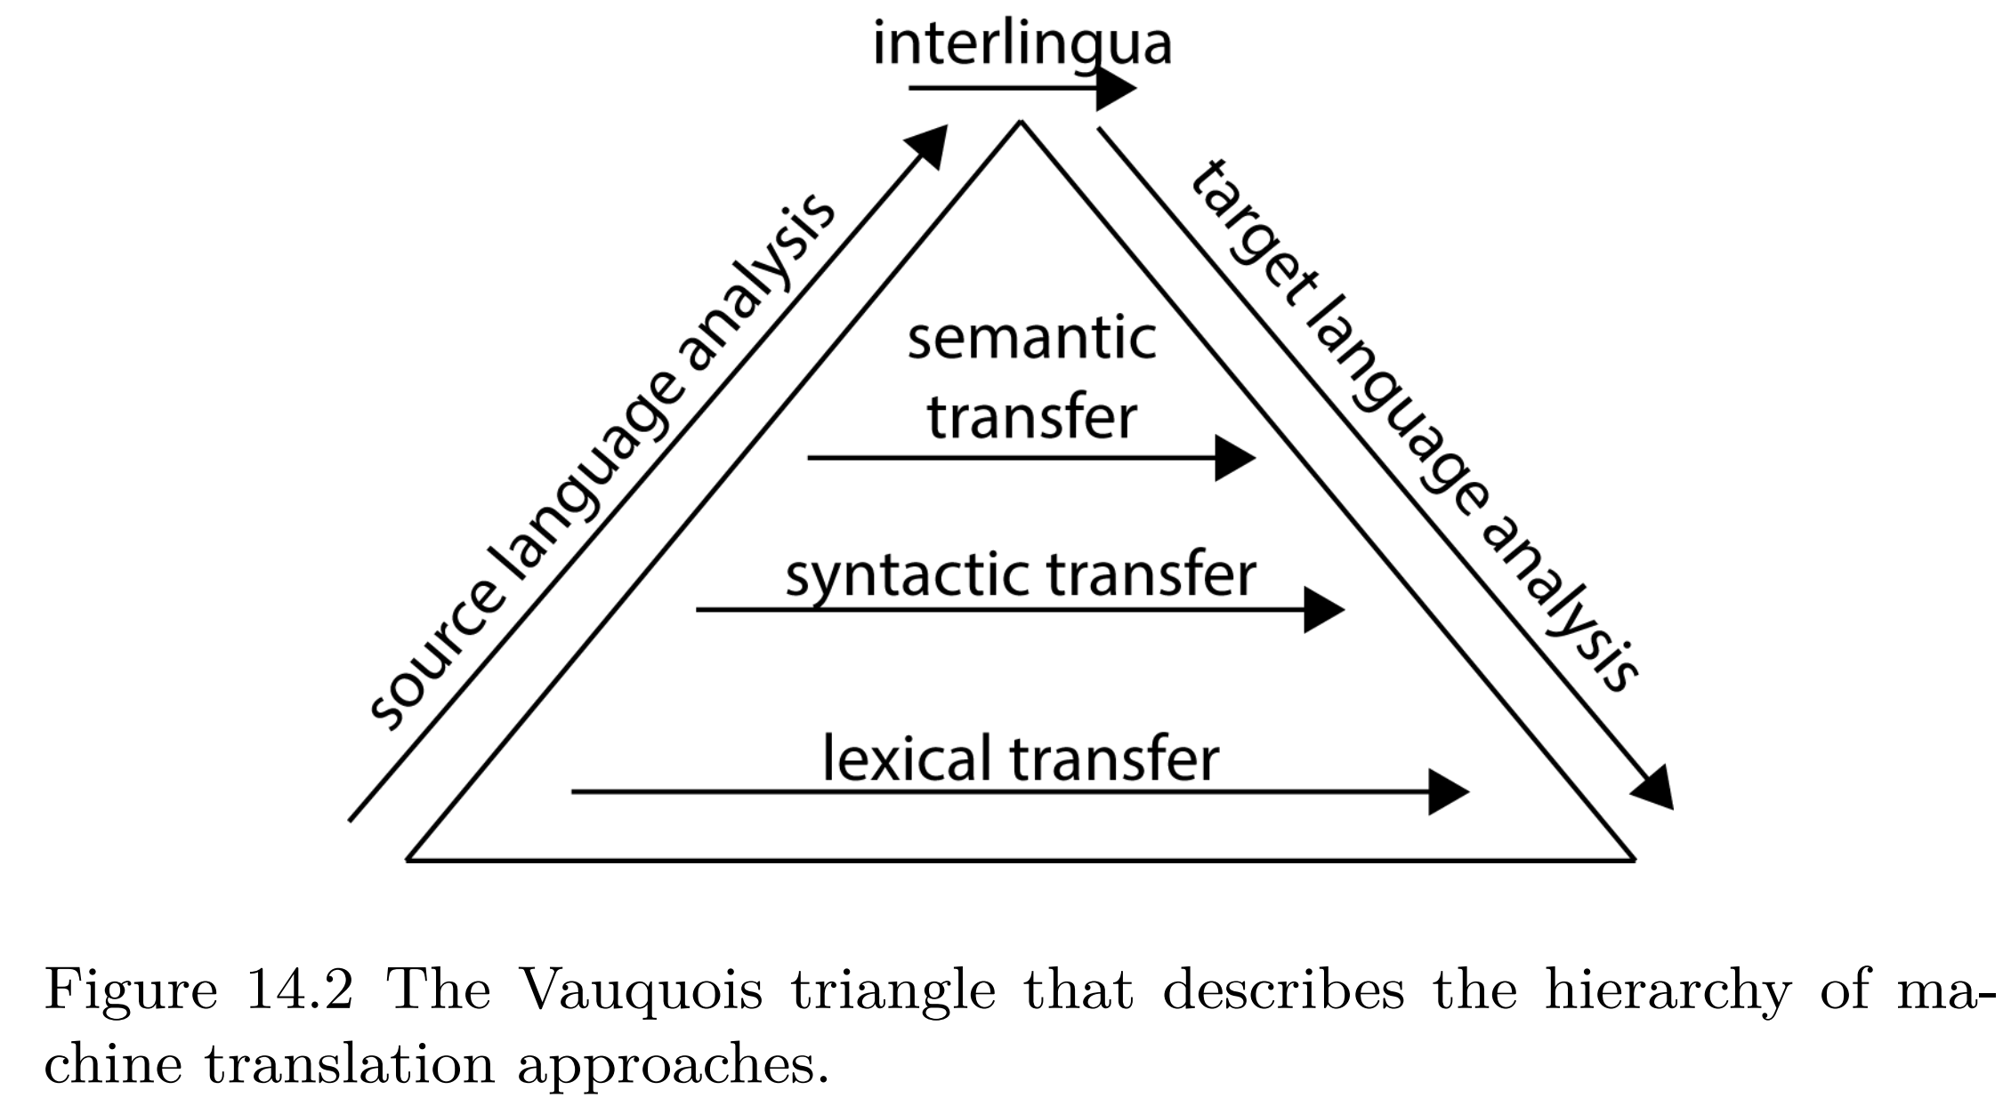
Vauquois triangle for machine translation

Slide 5

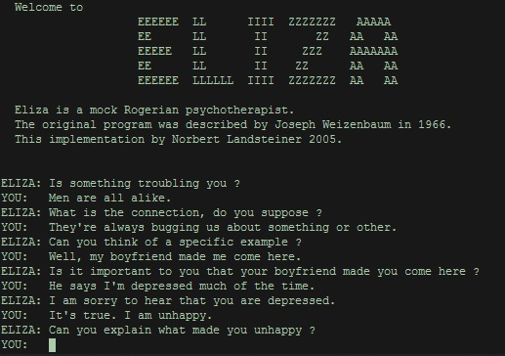
Chat bots

Slide 6
Overview
Evaluation measure (BLUE)
The first sequence-to-sequence architecture
Sequence-to-sequence with attention
Transformer-based encoder-decoder architectures
InstructGPT/ChatGPT

Slide 7
Evaluation measures

Slide 8
What are we evaluating?
Slide from http://jalammar.github.io/illustrated-transformer/

Slide 9
BLEU (bilingual evaluation understudy)
BLEU measures the word overlap between a candidate translation produced by the machine and a reference translation
BLUE “counts up the number of candidate translation words (unigrams) which occur in any reference translation and then divides by the total number of words in the candidate translation” (Papineni et al., 2002)

Slide 10
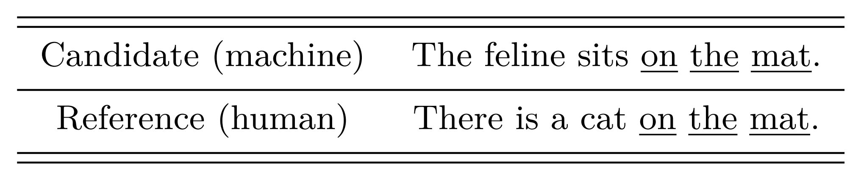
BLUE example
What is the BLUE score of the candidate translation?

Slide 11
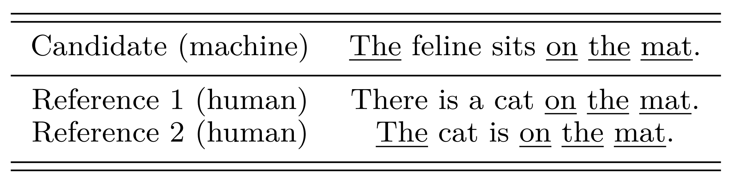
Multiple reference translations are allowed
What is the BLUE score of the candidate translation?

Slide 12
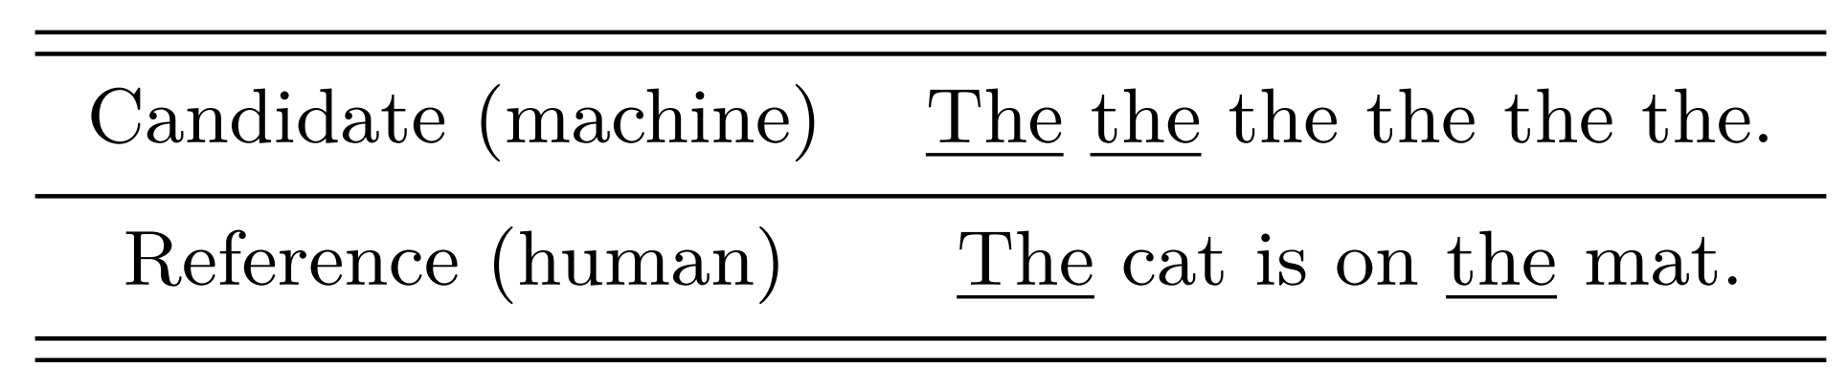
Avoiding metric abuse
BLEU allows each word from a reference translation to be used just once!
What is the BLUE score of the candidate translation?

Slide 13
Transformer-based encoder-decoder architectures

Slide 14
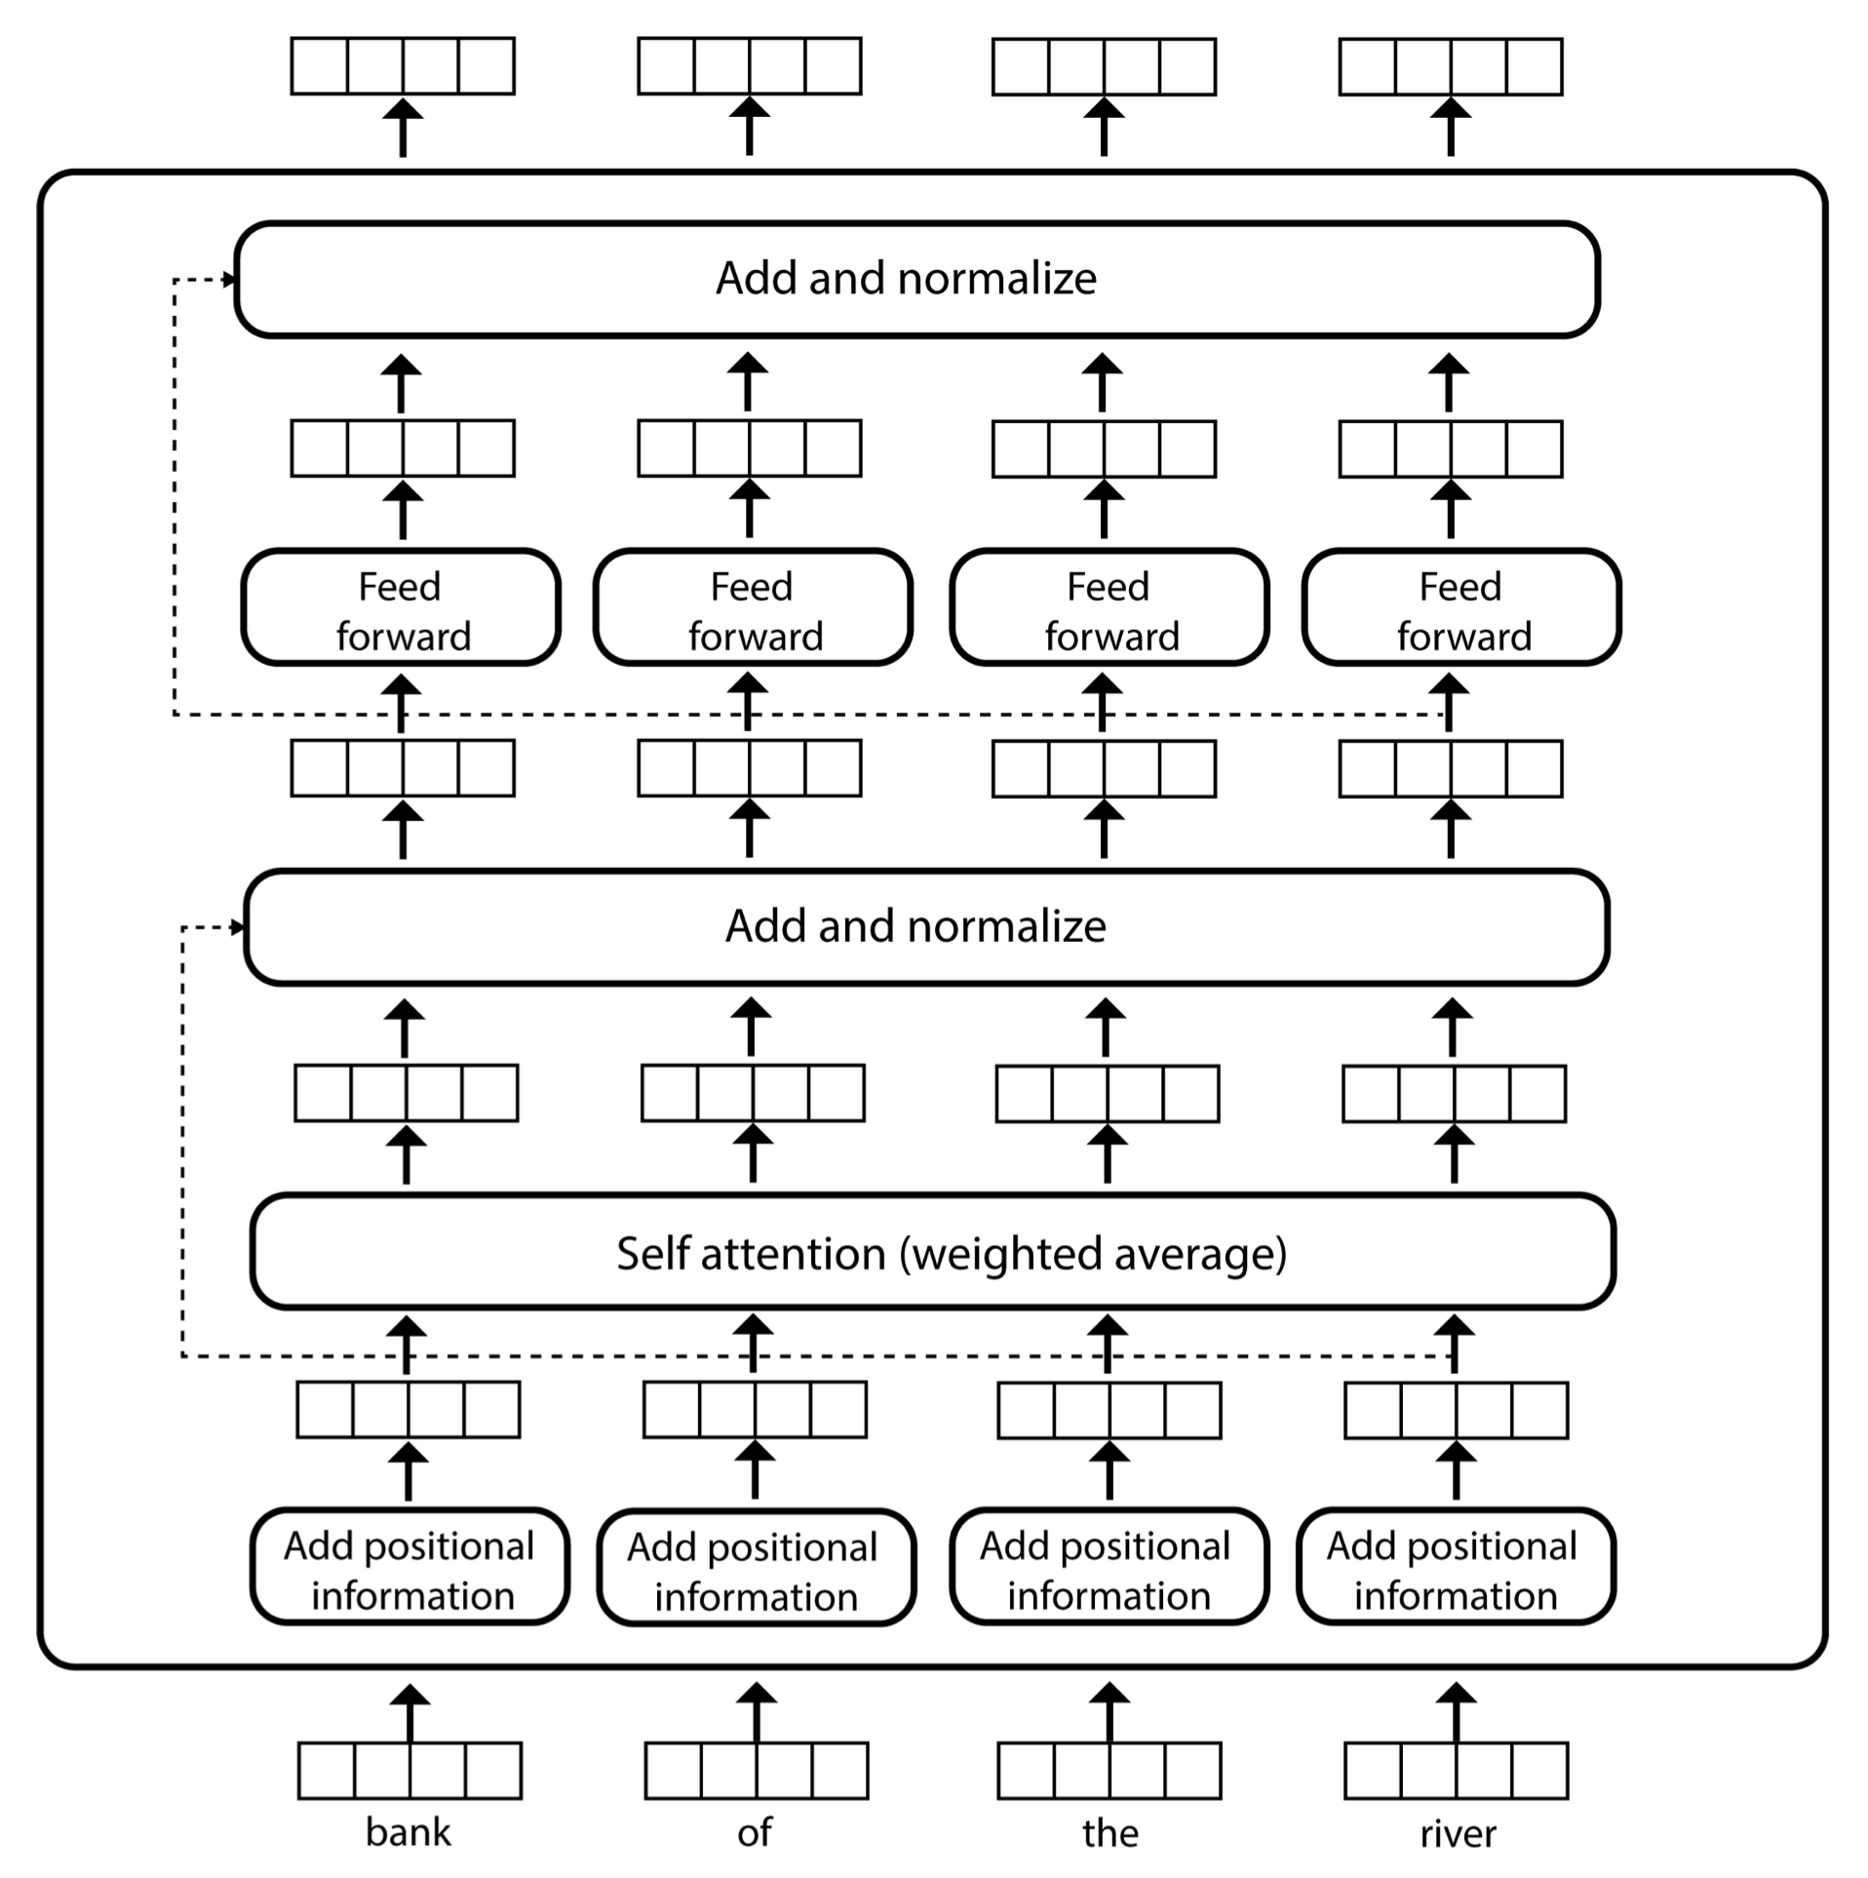
Reminder: encoder layer architecture

Slide 15
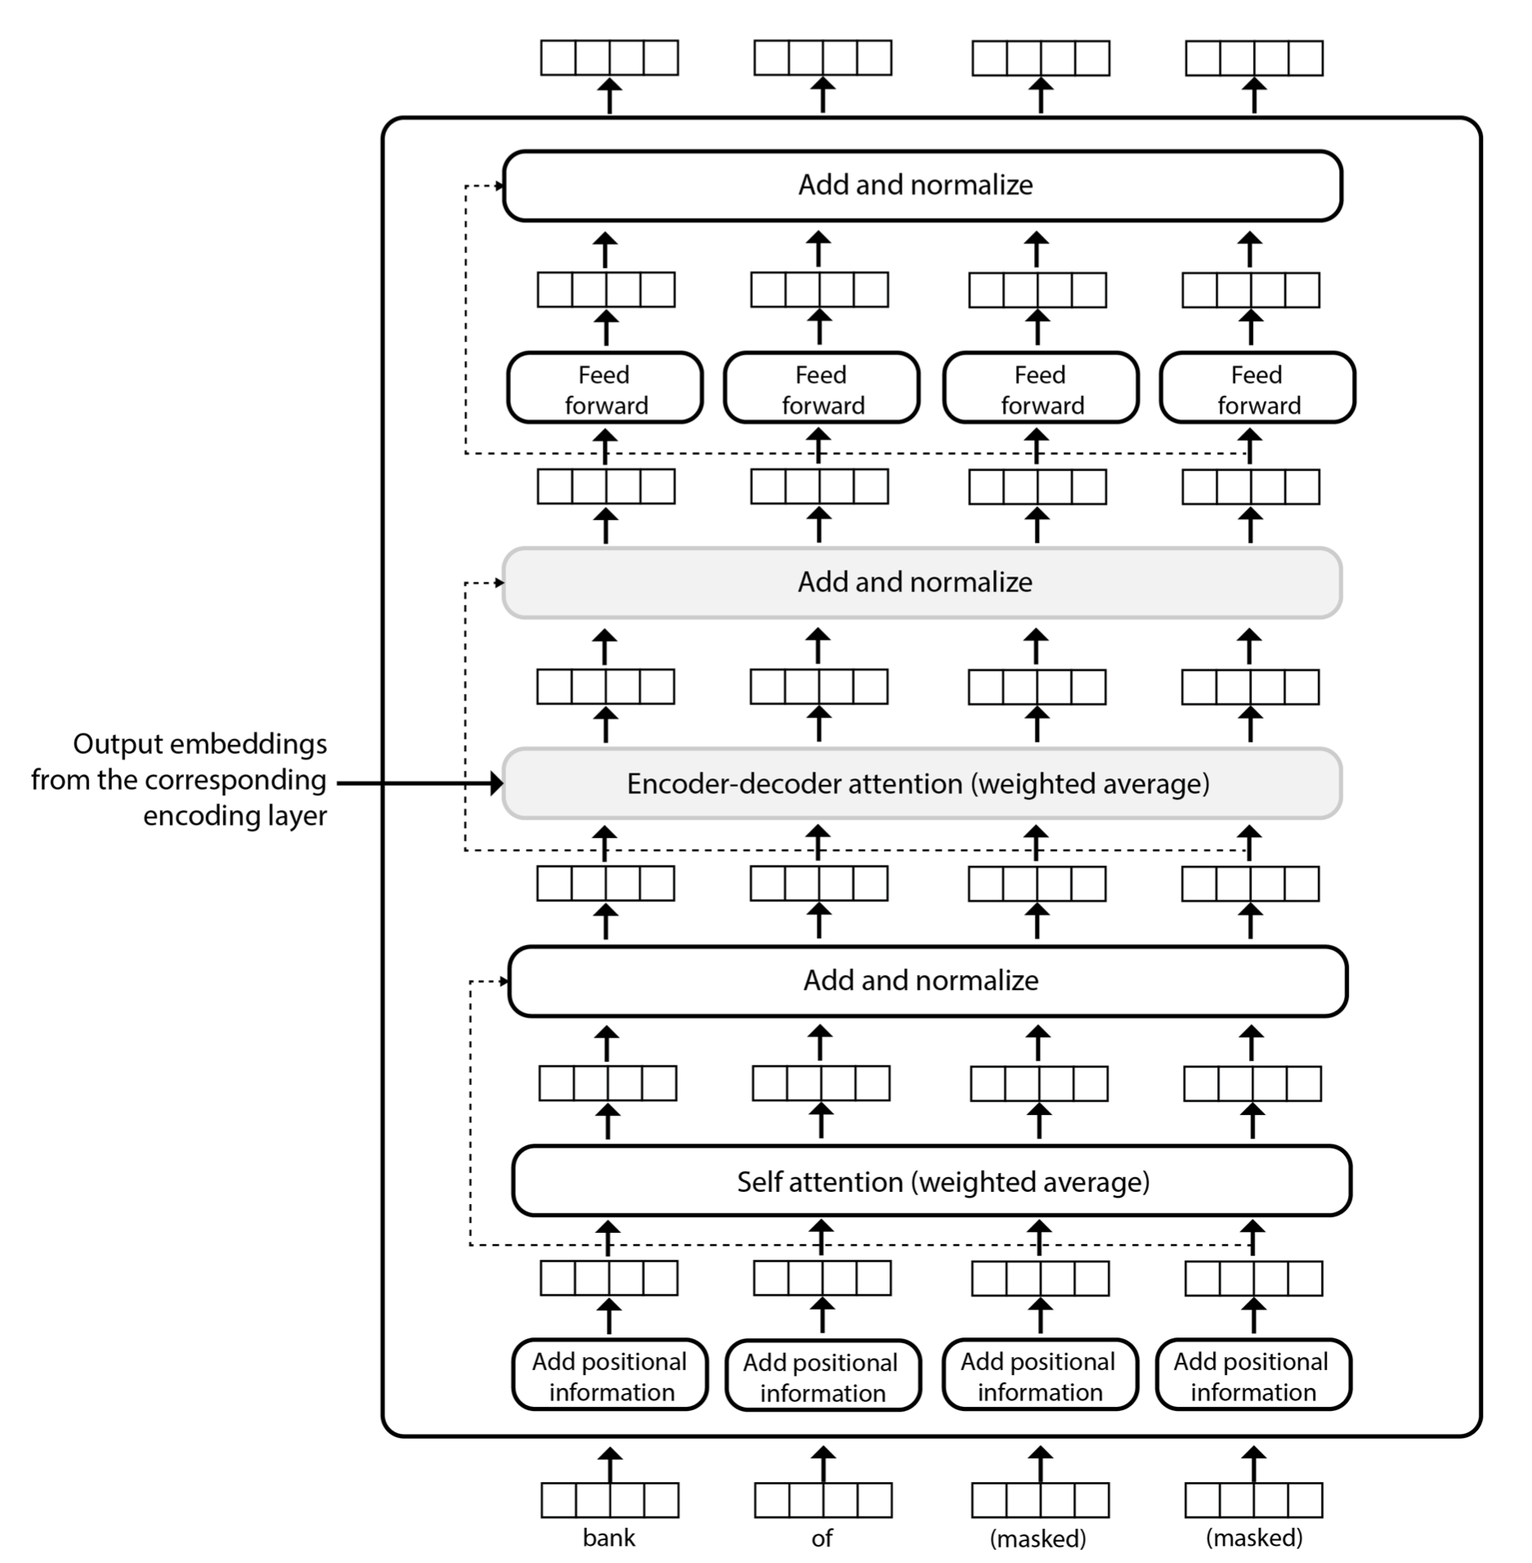
Decoder layer architecture
Attention over encoder embeddings
Can’t attend over tokens that have not been generated yet!

Slide 16
Three types of attention!
Encoder self-attention: see previous lecture
Decoder self-attention
Exactly the same math as the encoder self-attention, but
The decoder only has information about the words decoded so far. All other token placeholders are masked

Slide 17
Three types of attention!
Encoder-decoder attention
Same math as the previous self-attention components, but
The query vector q_{i} is computed using the representation produced by the decoder for the word at position i, and
The key and value vectors k_{j} and v_{j} are computed using the output embedding z_{j} produced by the corresponding encoding layer for the input token at position j

Slide 18

Visualizing all attention weights

Slide 19
Instructgpt / chatgpt

Slide 20
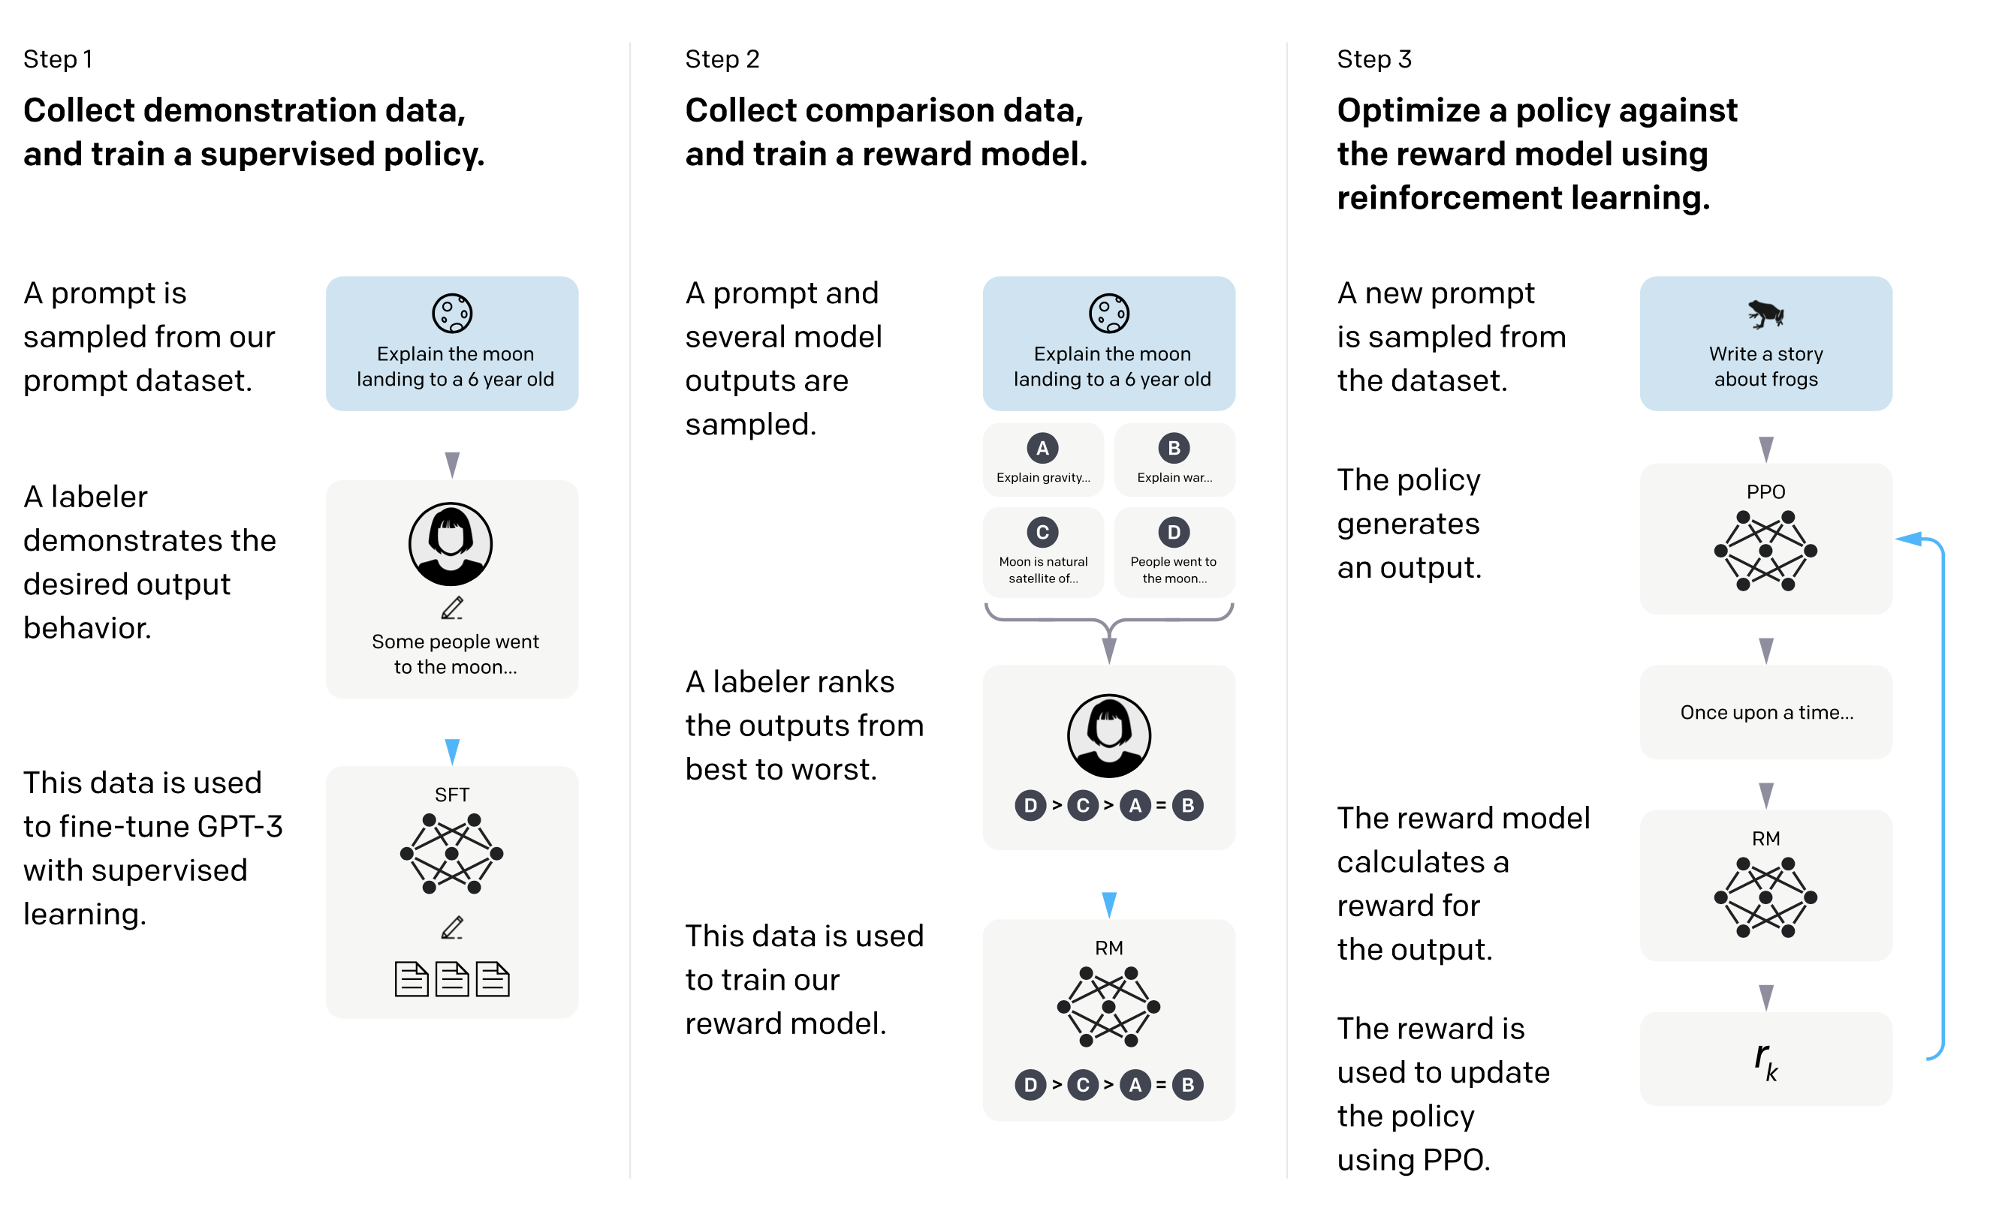
Three more steps
https://arxiv.org/abs/2203.02155

Slide 21
Three more steps
Same encoder-decoder strategy but with custom data generated by experts

Slide 22
Three more steps
A scoring/reward function that scores best answers higher than others

Slide 23
Three more steps
Train GPT* to respect the ranking induced by the previous function (not required in this course)

Slide 24
What problems do you see with this direction?

Slide 25
What problems do you see with this direction?
Contamination
Who made OpenAI the arbiter of correctness?
Human annotators are exposed to offensive content continuously for a measly pay

Slide 26
Take away
Evaluation measure (BLUE)
The first sequence-to-sequence architecture
Sequence-to-sequence with attention
Transformer-based encoder-decoder architectures
InstructGPT/ChatGPT

